Slide 1

Is Powdered Infant Formula Safe?
Elisabeth Sterken, MSc, Dt.
IBFAN Global Council
INFACT Canada

Slide 2
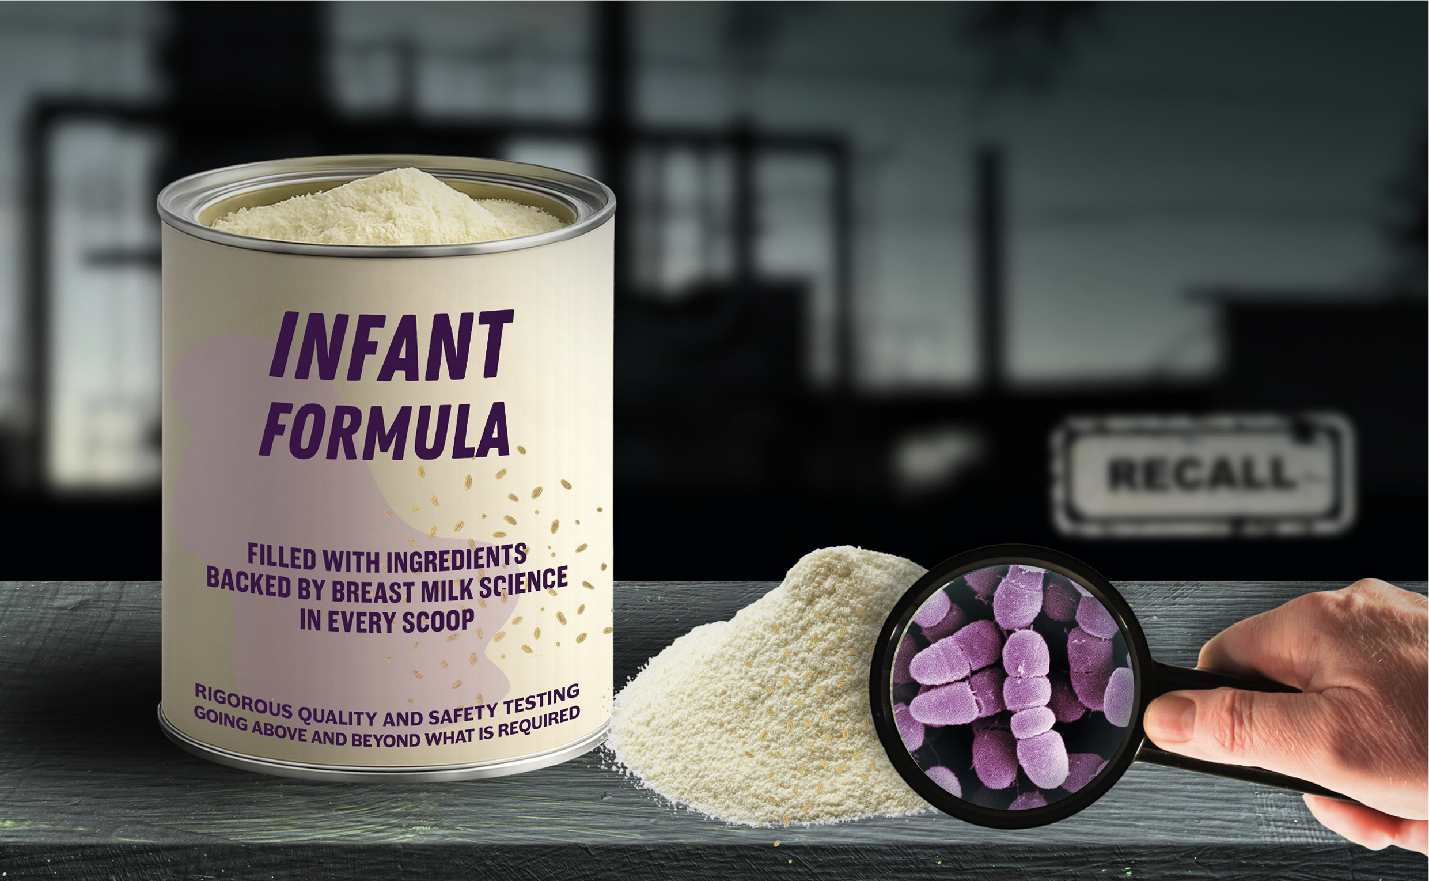
Botulism in a can

Slide 3
ByHeart
The ByHeart powdered infant formula (PIF) contaminated with Clostridium botulinum has resulted in over 100 cases under investigation in the US.
The company distributes its PIF via on-line platforms and is thus available in countries where the product is not registered for use. ByHeart was distributed to at least 20 countries - Argentina, Brazil, Brunei, Canada, Chile, China, Colombia, Ecuador, Egypt, Hong Kong, Jamaica, Japan, Republic of Korea, Peru, Philippines, Romania.

Slide 4
C. botulinum
Clostridium botulinum is a spore forming, anaerobic that produces the highly dangerous botulinum neurotoxin.
C. botulinum spores are heat resistant that can survive boiling temperatures and are very difficult to destroy.
Reconstituted formula is a high nutrient substrate for spores to germinate and rapid growth of the C. botulinum and the production of botulinum toxin.

Slide 5

Botulinum toxin
Botulinum toxin attacks the nervous system - muscle weakness – constipation reduced peristalsis, weak crying, floppy tone, diminished reflexes, lethargy, shallow breathing – leading to respiratory failure, paralysis – and may cause death.

Slide 6
Treatment
Infant botulism is a serious condition that must be treated as quickly as possible. Botulism Immune Globulin (referred to as BabyBig) administered intravenously is the single treatment for infants under one year of age and is only available in the US.
Access to the BabyBig treatment outside of the US is only on ‘a case-by-case evaluation basis.’ International requests must go through an onerous process requiring the affected infant’s attending physician to contact an on-call BabyBig physician for approval; after which a letter of authorization from the importing country’s Medicine Regulatory Authority must be issued; payment made; customs cleared; all with a required international courier account and more.
Needless to say, access to treatment for infants diagnosed with botulism outside of the US, is likely to be a costly and time consuming process that will be unavailable or too late for many Nor do we have information about cases outside of the US.

Slide 7
FDA Inspection
US Food and Drug inspection documents of the production facilities of the C botulinum contaminated PIF (although with some redaction) released in late November, reveal systemic violations of hygienic controls. These include:
receiving and releasing X ingredient used in infant formula powder that was not held under conditions that prevent adulteration
not taking action to eliminate rodent issues
not monitoring floor conditions adequately
approval and release of an ingredient that was not manufactured, packaged, labelled or held under conditions that prevent adulteration,
did not remove pest from plant to protect against contamination,
did not maintain the manufacturing building in clean and sanitary condition

Slide 8
Bacillus cereus in a can
Bacillus cereus is yet another spore forming microbe that produces the toxic metabolite cereulide
So far the recall is in nearly 60 countries - Asia, Africa, the Americas, Australia, Hong Kong, Turkey,
The recall is across N major brands – SMA, Beba, Nan, Alfamino, Nidal, Lactogen Harmony, S-26 - over 800 batches and 10 production sites. The largest recall in N history.
The ingredient arachidonic acid (ARA) which is present as an optional ingredient and on which claims are made for supporting eye and brain development demonstrates the risk of permitting ingredients that are not mandatory. However optional ingredients are favoured by the industry as they are used to make nutrition and health claims which are often not substantiated with independent research.

Slide 9
Nestle’s cereulide
Symptoms: severe, persistent vomiting, diarrhhoea, abdominal pain/cramps – symptoms appearing as quickly as 30 minutes after ingestion and up to 6 hours after ingestion.
Brazil has confirmed 2 cases of illness - persistent vomiting and diarrhea linked to consuming recalled formula

Slide 10
Can PIF be a safe sole source of nutrition for infants?
PIF is marketed for newborn infant, older infants, premature infants, infants with special needs,
Spores of toxin producing microbes are extremely difficult to destroy, requiring high heat and pressure,
Conditions to kill spores would destroy the nutritional adequacy of PIF,
Studies show current recommendations for reconstitution do not remove all microbial contaminants,
Microbial risks are in addition to the well documented risks of formula feeding, Not only health consequences of inappropriate ingredients but also industrial and chemical contamination,
Risks are greater in Global South and in emergency settings, especially when access to clean water, fuel, refrigeration, treatment are less accessable,,
Marketing is not restricted in many countries. PIF is not safe and infants need to be protected from needless use.

Slide 11
The Role of Codex
IBFAN requested the December 2025 meeting of the Committee on Food Hygiene to review and update the Codex Code of Hygienic Practice for Powdered Infant Formula for Infants to address the concern of Clostridium botulinum contamination as well as Bacillus cereus and also the frequent recalls for Cronobacter sakazakii and Salmonella species.

Slide 12
CCFH outcomes
The CCFH has requested JEMRA* to conduct a risk assessment on spore-forming pathogens - C. botulinum and B. cereus in PIF and update the risk assessments for Cronobacter and Salmonela species in PIF and provide scientific advice on control measures to the CCFH
However no specific timelines and generally these requests take at least 1 to 2 years.
From JEMRA the advice goes to the CCFH which will then form working groups for updating the Code of Hygienic Practice. Once agreement is reached at the CCFH it will advance to the CAC for final adoption. This process may take a minimum of 3 years
Given the serious health consequences for this very vulnerable population and frequency of contamination recalls, it is essential that this process receive expediated priority.
*Joint FAO/WHO Expert Meetings on Microbiological Risk Assessment

Slide 13
IBFAN’s call to Action
Codex to update the Code of Hygienic Practice for PIF,
WHO to update the WHO Guidelines on the safe preparation, storage and handling of PIF,
A WHA resolution to address risks of formula contamination,
National robust regulations, pre-market control, with independent frequent inspection, sanctions for violations,
Mandatory reporting of illness from contaminated PIF,
Expediated recall systems and risk communication, warning parents and informing on measures for disposal of products,
Importantly, for all countries to regulate into law the International Code and WHA resolutions to ensure that breastfeeding is protected as the norm and to prevent needless reliance on commercial formula products.

