Slide 1
The tale of three infant formula crisis
Vitamin B and iodine
ITX
Melamine
Yasmine Motarjemi
21 January 2026

Slide 2
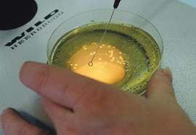
Examples of Foodborne hazards
Biological Hazards
  Bacteria: Aeromonas, Bacillus cereus, Clostridium perfrigens, Clostridium botulinum, Campyloabcter spp, pathogenic E.coli, Listeria monocytogenes, Salmonella, Salmonella typhi and paratyphi Shigella spp, Staphylococcus aureus, Vibrio parahaemoyticus, Vibrio vulnificus
  Viruses: hepatitis A virus, norovirus
  Parasites: Trichinella, Toxoplasma gondii, Cryptosporidium, helminths
Chemicals
  Agrochemical e.g. antibiotics, pesticides...
  Environmental contaminants e.g. dioxin, heavy metals,...
  Naturally occurring toxins e.g. aflatoxin, marine toxins, plant toxicants
  Processing contaminants: acrylamide, 3MCPD
  Packaging chemicals
  Diverse substances:
    Accidental contamination with disinfectants and cleaning agents, lubricants
    Adulteration, e. g. use of unauthorised substances such as the dye Sudan
Physical hazards
  Metal, glass, etc.
  Choking
Prions
Allergens
  Nuts, peanuts, milk, egg, fish, crustaceans, soya, gluten containing cereals
Nutritional hazards
  Trans fatty acid, essential micronutrients

Slide 3
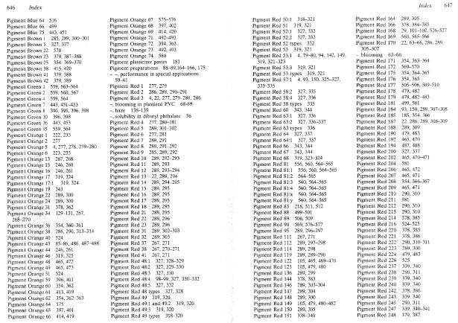
Potential pigments for adulteration

Slide 4
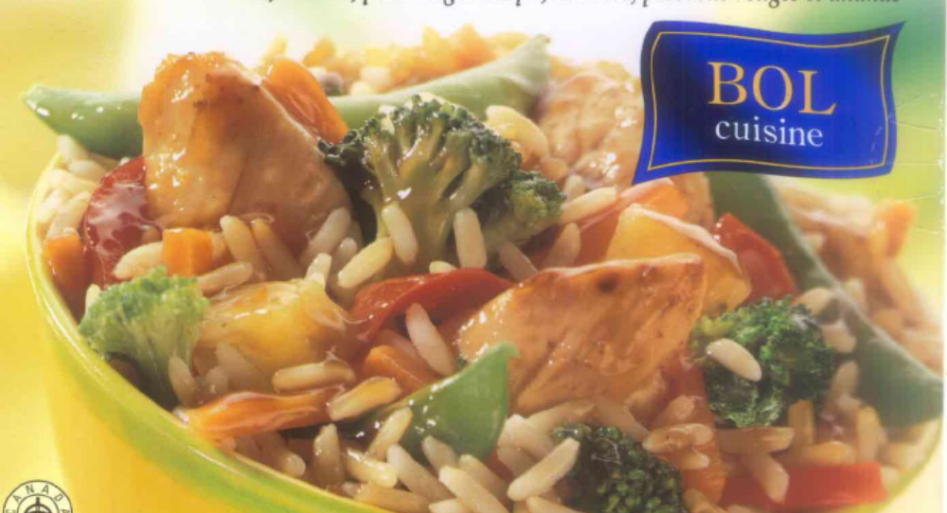
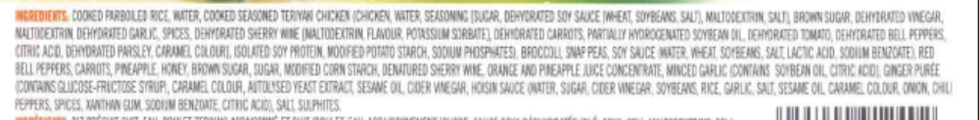
Complexity of the supply chain and/or of food operations
Sophistication of products
  Multitude of ingredients
  Ingredients with variable source
Continuous changes:
  Recipe
  Supplier
  Exporting market
  Production line
  Personnel
  Maintenance work in the factories
Segregation of food-grade and non food-grade ingredients

Slide 5
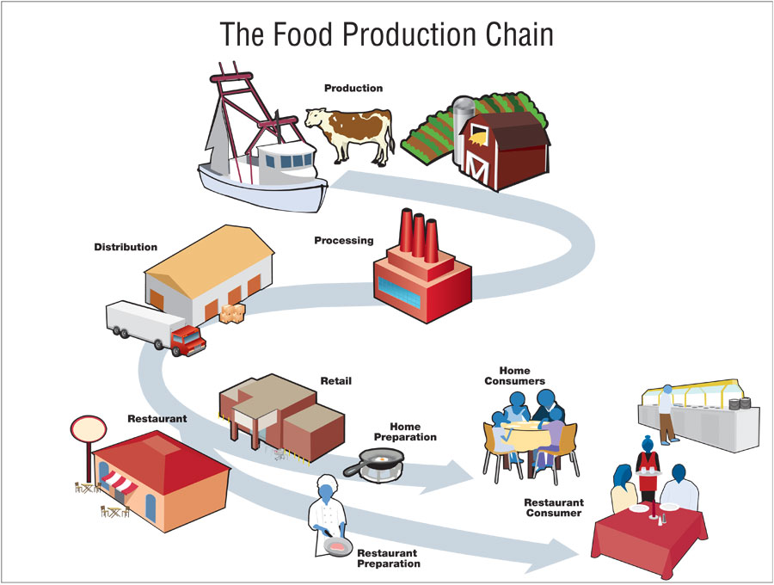
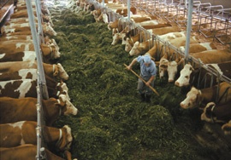


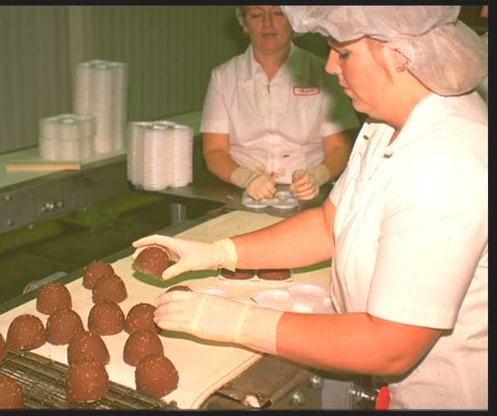





Complexity of food supply
Source: CDC, USA
which leave

Slide 6

Science Education,
Research,
Expertise
Hazard identification
Exposure assessment
Risk Assessment
Hazard characterization
Academia
HACCP &
Regulatory Compliance
Basic Hygiene & Regulatory Compliance
Verifications
Include: monitoring raw material and auditing suppliers,
end-product testing, environmental monitoring, audits,
consumer complain handling
.
Legislation:
Regulations
Standards
Enforcement: Training, Information
Control &
inspection
Food Safety
Assurance
System
Traceability
Risk
Assessment
Risk
Management and Communication
Training
Root cause
Analysis,
Review and
Evaluation
Incident Management & Recall
Evaluation: Monitoring,
Analysis and Reporting
Consumer Education and Information
Food
Industry
Information
Good Practice
Government
Consumers

Slide 7
Food Safety Management System
FOOD SAFETY ASSURANCE SYSTEM
FOOD SAFETY ASSURANCE SYSTEM
Good Hygienic
Practices
HACCP
Verifications
Layout and building design
Processing equipment
Maintenance and services
Incoming materials handling
Processing
Cleaning and disinfection
Storage, transport & distribution
Personal hygiene
Pest prevention
Security measures
Conducting hazard analysis
Determining Critical Control
Points (CCP)
Establishing Critical Limits (CL)
Establishing monitoring
Establishing corrective actions
Establishing verification
procedures
Establishing documentation
and records
Raw material &
product testing
Environmental monitoring
Maintenance checks
Release of products
Audits
Employee reports (whistleblowing)
Consumer complaint handling
Traceability, Recall Procedures, Crisis Management
Management commitment, Human Resource Management and Training
Notes:
In general we have a robust system of food safety management

Slide 8
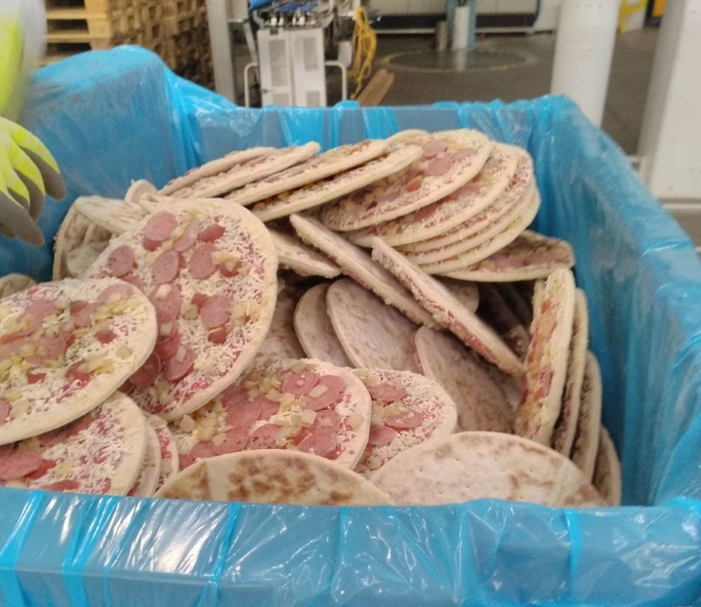
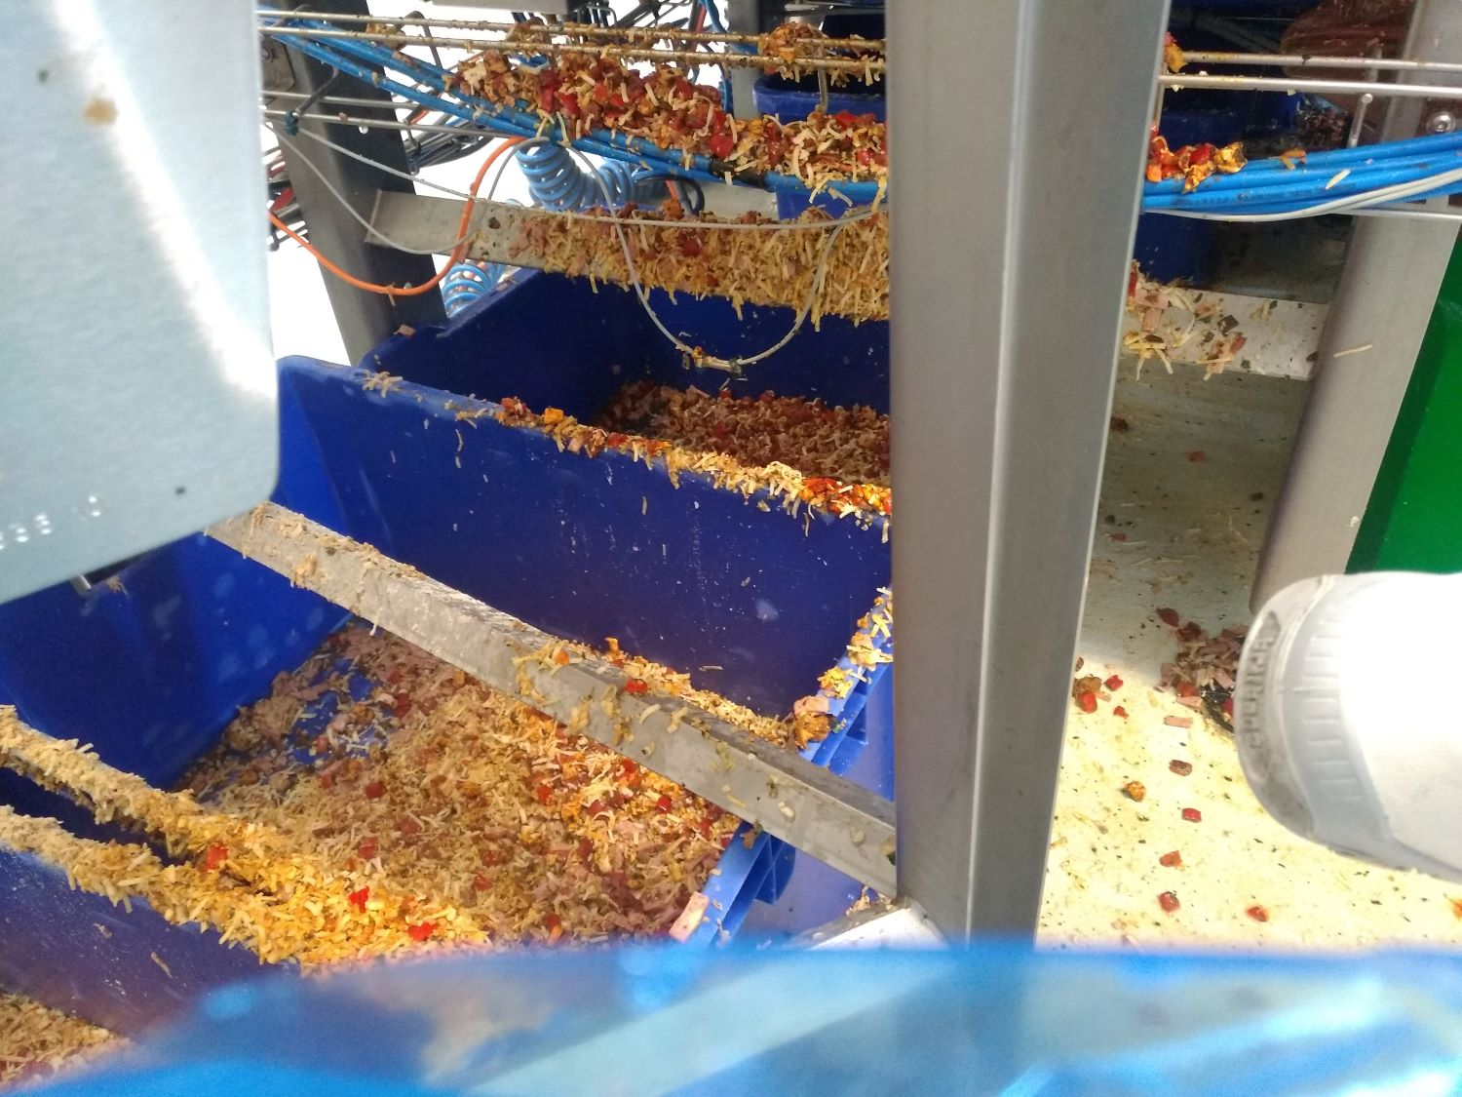
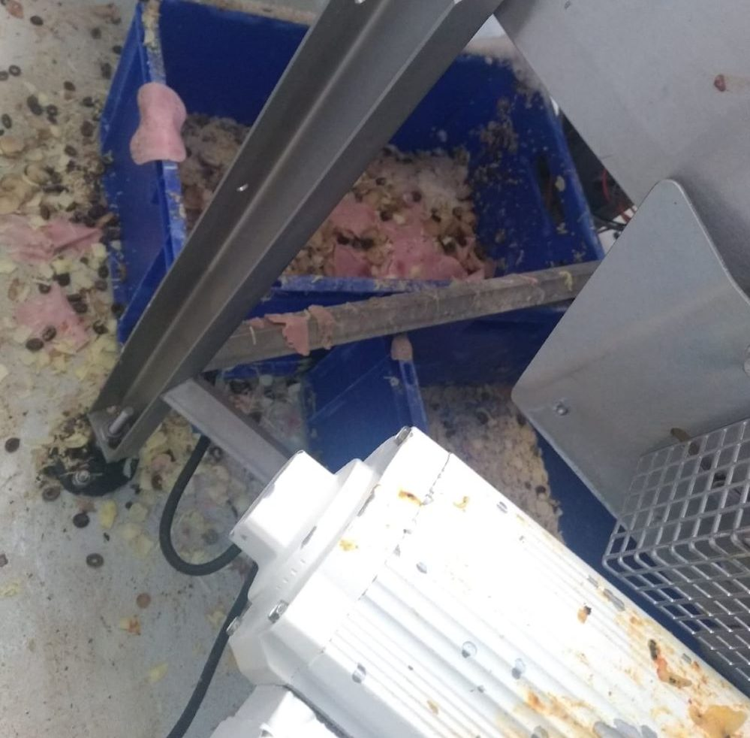
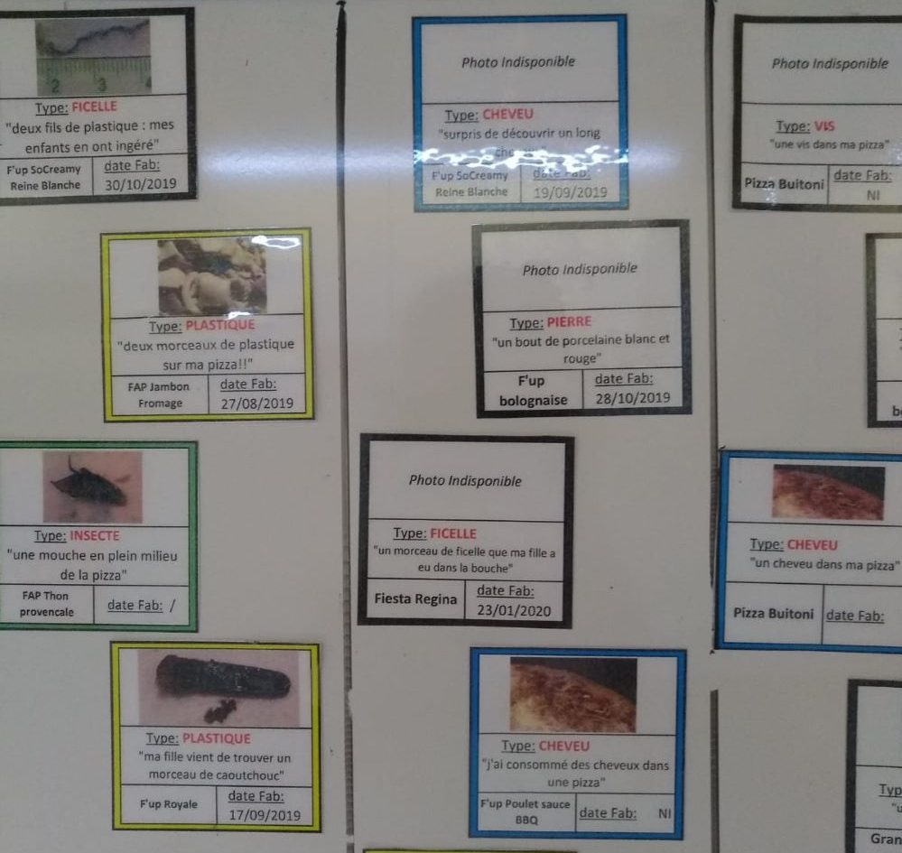
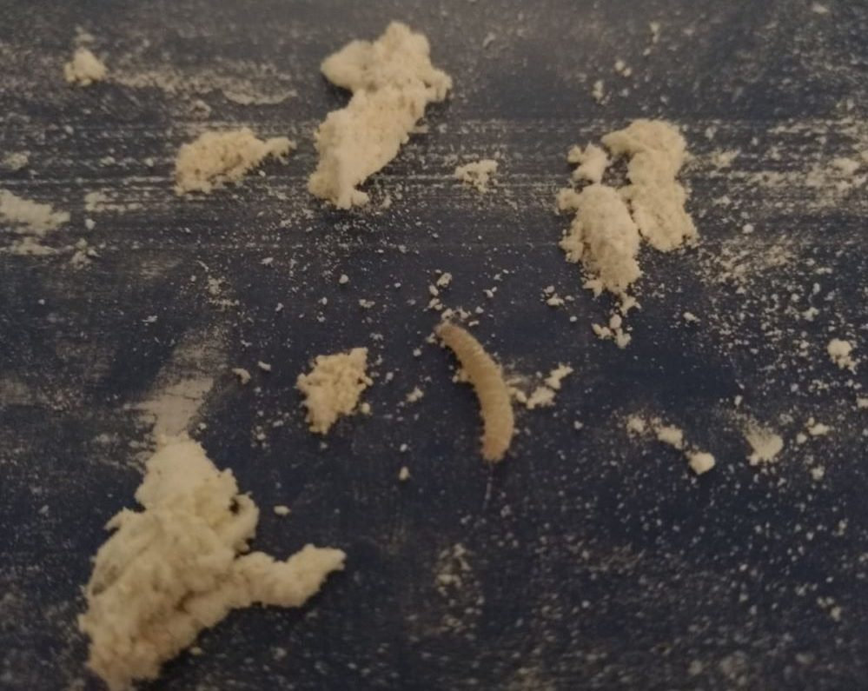
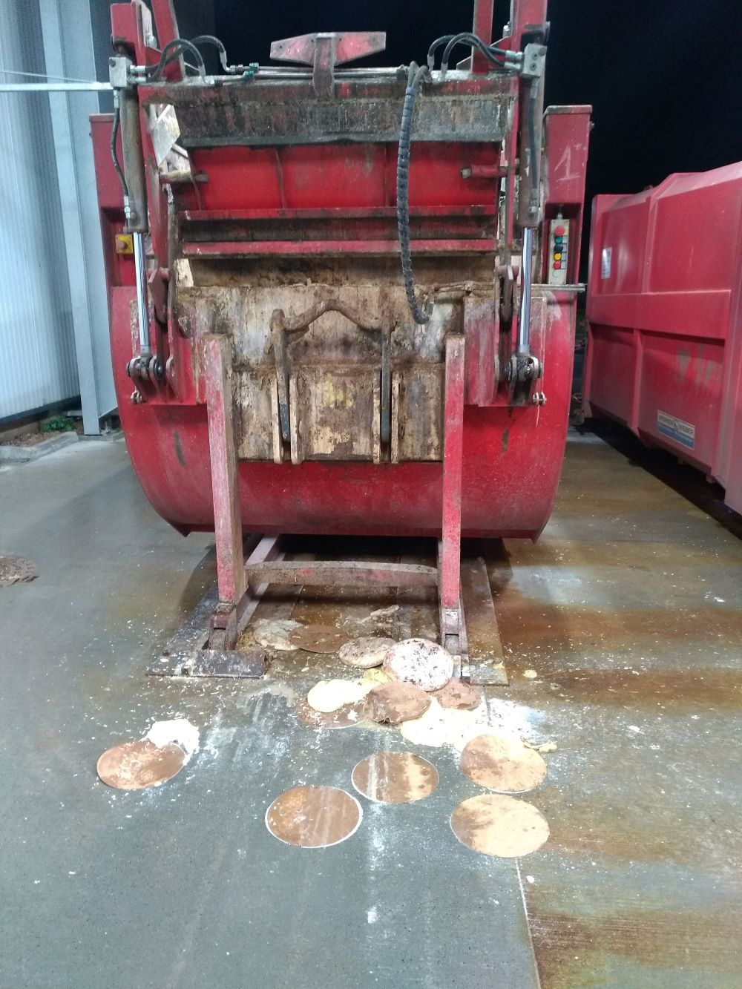
Buitoni outbreak
Investigative media reports
Poor hygiene in the factory
Photos reported by an employee in Mai 2021, a year before the outbreak
Personal hygiene neglected
Cleaning procedure shortened
Execution transferred to employees exhausted and not sufficiently skillied.
Internal complaints of employees ignored
Notes:
The poor hygiene practices in the factory is indeed is a sign of poor food safety management, but not necessarily the cause of the outbreak

Slide 9
Food Safety Management System
FOOD SAFETY ASSURANCE SYSTEM
FOOD SAFETY ASSURANCE SYSTEM
Good Hygienic
Practices
HACCP
Verifications
Layout and building design
Processing equipment
Maintenance and services
Incoming materials handling
Processing
Cleaning and disinfection
Storage, transport & distribution
Personal hygiene
Pest prevention
Security measures
Conducting hazard analysis
Determining Critical Control
Points (CCP)
Establishing Critical Limits (CL)
Establishing monitoring
Establishing corrective actions
Establishing verification
procedures
Establishing documentation
and records
Raw material &
product testing
Environmental monitoring
Maintenance checks
Release of products
Audits
Employee reports (whistleblowing)
Consumer complaint handling
Traceability, Recall Procedures, Crisis Management
Management commitment, Human Resource Management and Training
Notes:
In general we have a robust system of food safety management

Slide 10

Incidents

Slide 11


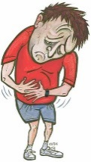
Hazards
Gaps
Losses
Organisation
Workplace
Person
Defences
Managerial decisions and organisational structure
Conditions
prone to errors
or violations
Errors
Incident
Violations
Latent failure pathway
Adapted from Reason, J. T. (1997)

Slide 12
The tale of three infant formula crisis
Vitamin B and iodine
ITX
Melamine

Slide 13
Latent failure
Position of QA vacant ?
Latent failure
Lack of training/
perception on importance of vitamins ?
Active failure
Not reviewing
the results of the lab
Secretary not
trained for the job ?
Latent failure
Understaffed
administrative
support ?
Latent failure
Human error in
sending the request
for testing
Active failure
Infant formula &
Vitamin B1 deficiency
Incident
Active failure
Mistake in
product formulation

Slide 14
Lack of
infrastructure
Latent failure
Lack of expertise
of food processors
& poor communication
between stakeholders
Latent failure
No monitoring or
auditing of supplier
for the ITX
Active failure
Importance of
Quality assurance
System?
Latent failure
Lack of expertise
of packaging industry
& incorrect legislation
Latent failure
Incorrect method
for testing migration
of ITX into food products
Active failure
ITX Crisis 2005

Slide 15
Food Safety Management System
FOOD SAFETY ASSURANCE SYSTEM
FOOD SAFETY ASSURANCE SYSTEM
Good Hygienic
Practices
HACCP
Verifications
Layout and building design
Processing equipment
Maintenance and services
Incoming materials handling
Processing
Cleaning and disinfection
Storage, transport & distribution
Personal hygiene
Pest prevention
Security measures
Conducting hazard analysis
Determining Critical Control
Points (CCP)
Establishing Critical Limits (CL)
Establishing monitoring
Establishing corrective actions
Establishing verification
procedures
Establishing documentation
and records
Raw material &
product testing
Environmental monitoring
Maintenance checks
Release of products
Audits
Employee reports (whistleblowing)
Consumer complaint handling
Traceability, Recall Procedures, Crisis Management
Management commitment, Human Resource Management and Training
Notes:
In general we have a robust system of food safety management

Slide 16
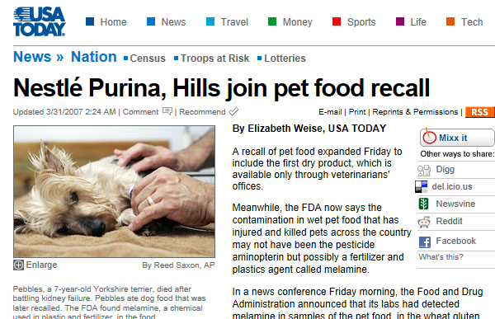
Incident of melamine, «pet food» USA, 2007

Slide 17
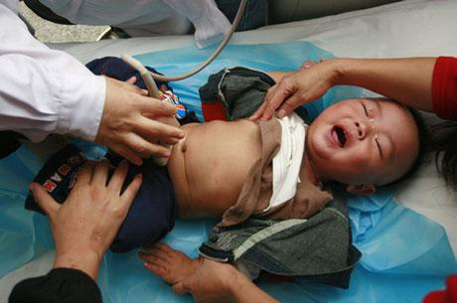
Incident of melamine, «infant formula »,
China, 2008
300 000 infants intoxicated
> 6 deaths

Slide 18
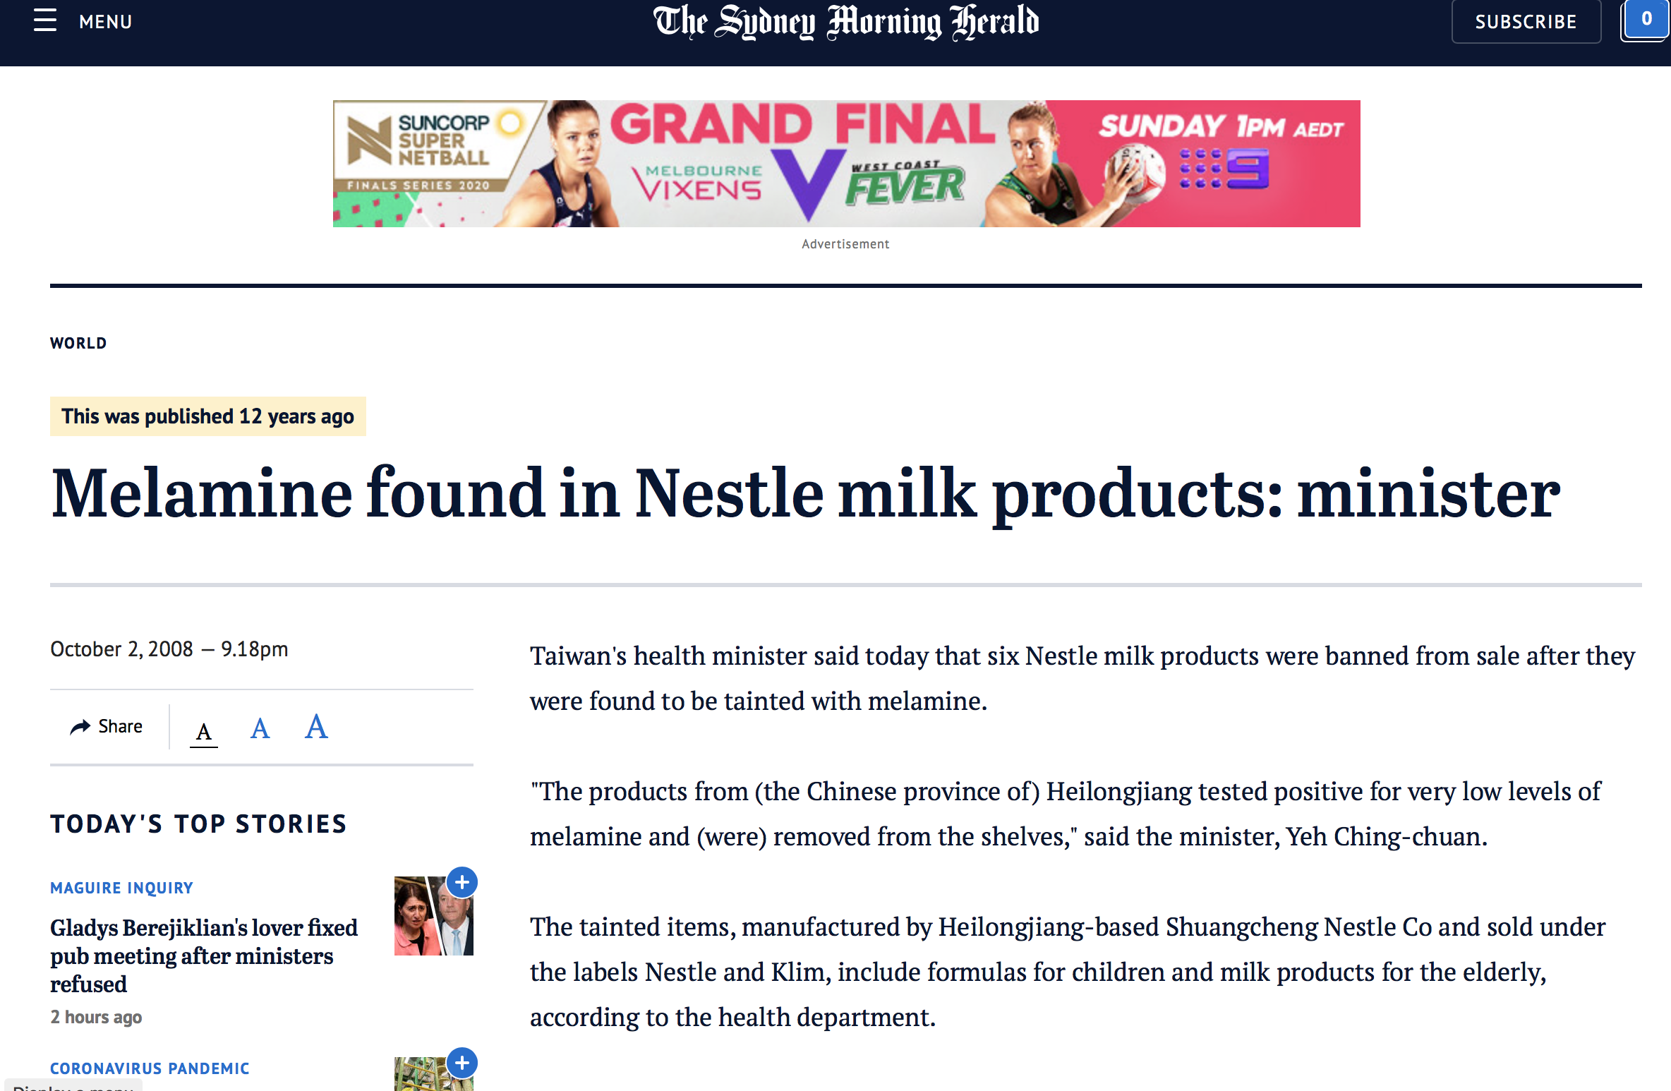
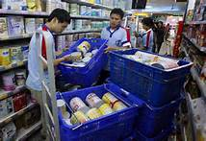

Slide 19
Inappropriate managerial decisions and structure
Latent failure
Company culture: cronyism, fear, favoritism, double language, discrimination, harassment
Latent failure
Active failure
Failure in following up internal whistleblowing
Retaliatory measures
against the
food safety manager
Active failure
Appointment of a director
lacking competence
in food safety management/
interested in the bonus
Latent failure
Failure in investigating other potential sources of contamination
following the 2007 crisis in
USA with pet food
Active failure
Failure in considering the risk of melamine in the raw material and verifying raw materials (failure in application of HACCP)
Active failure
Melamine incident
(China, 2008)

